Slide 1

One Stop-Property
This initiative introduces a comprehensive all in one Property Management System engineered to transform property operations through streamlined workflows and enhanced service delivery. The platform will drive operational excellence while maximizing user satisfaction across all stakeholder touchpoints.

Slide 2
Problem statement:
Current property management operations suffer from critical inefficiencies due to fragmented service delivery across booking, rental, and maintenance functions. The absence of a centralized platform forces users to navigate multiple systems for property listings, maintenance coordination, inspection scheduling, and financial aid applications. Furthermore, the lack of standardized comparison tools complicates loan scheme evaluation and builder service selection, while inadequate post-purchase support infrastructure creates ongoing inconveniences for property owners.

Slide 3
Solution Overview:
The proposed system delivers a fully integrated platform that centralizes all property services within a single ecosystem. Key capabilities include property search and booking functionality for both rental and purchase transactions, on-demand inspection scheduling, comprehensive maintenance service access, and comparative analytics for loan schemes and builder service offerings. This consolidation eliminates operational silos and simplifies property management workflows.

Slide 4
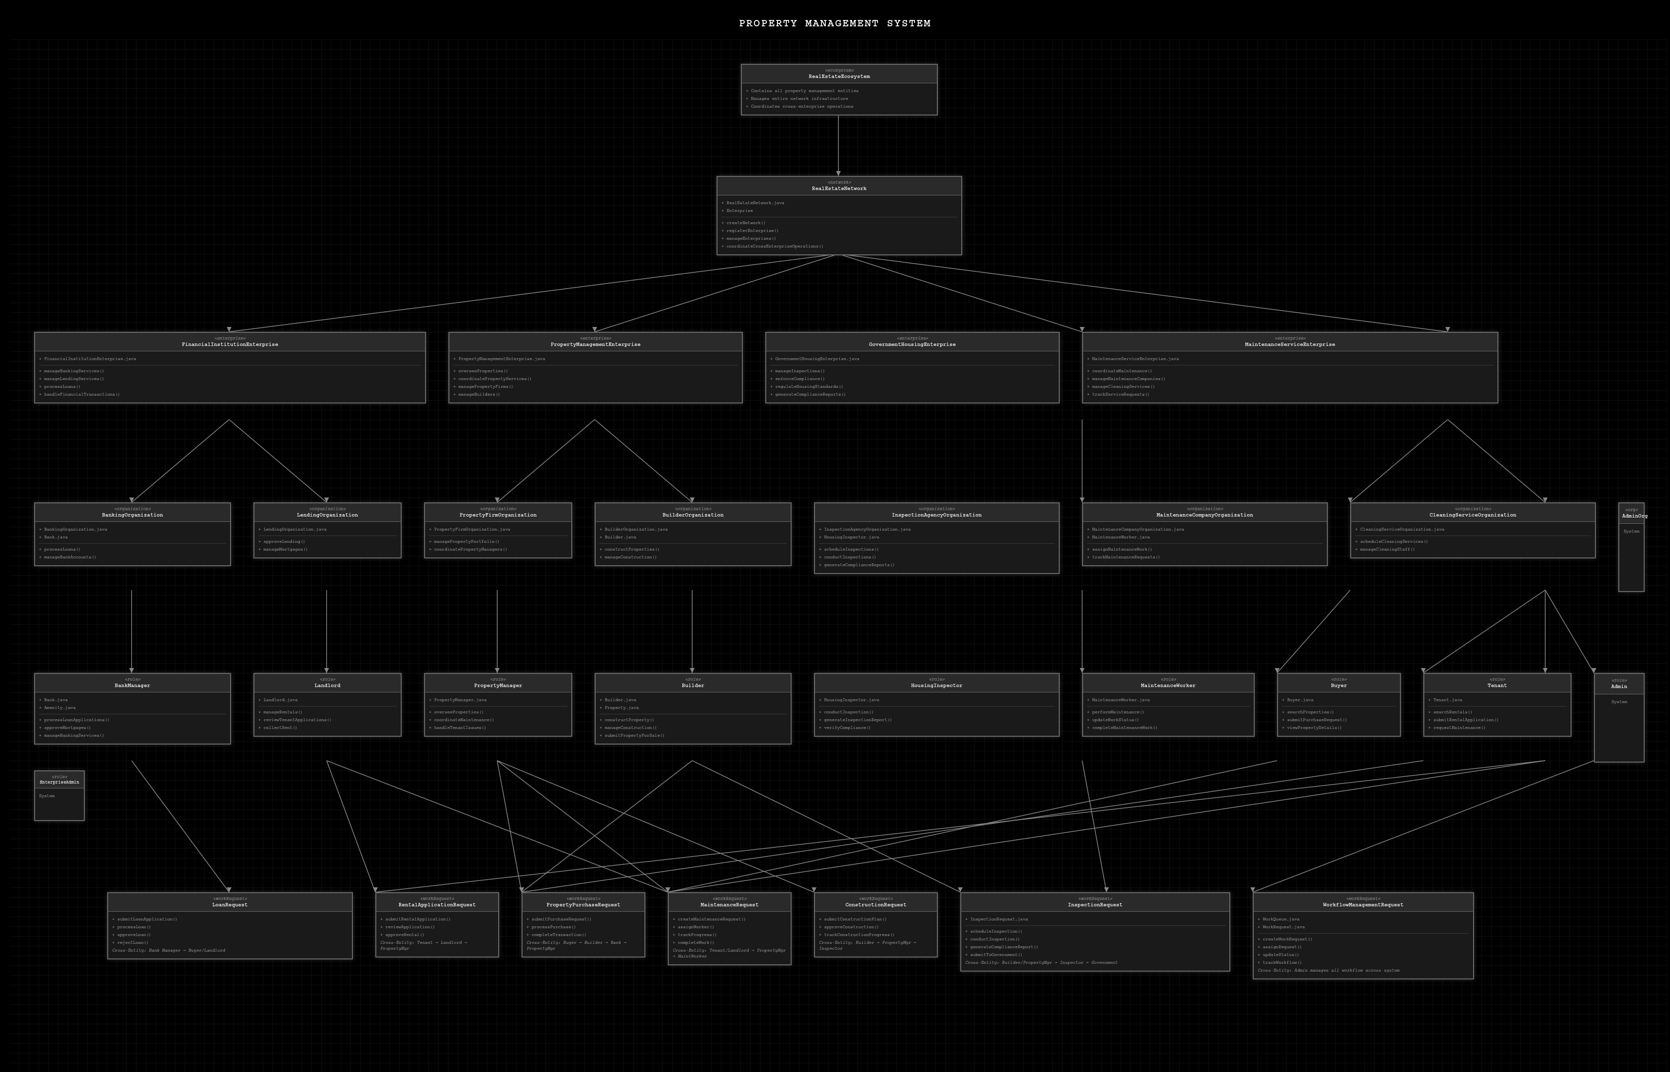
HIGH LEVEL DIAGRAM

Slide 5
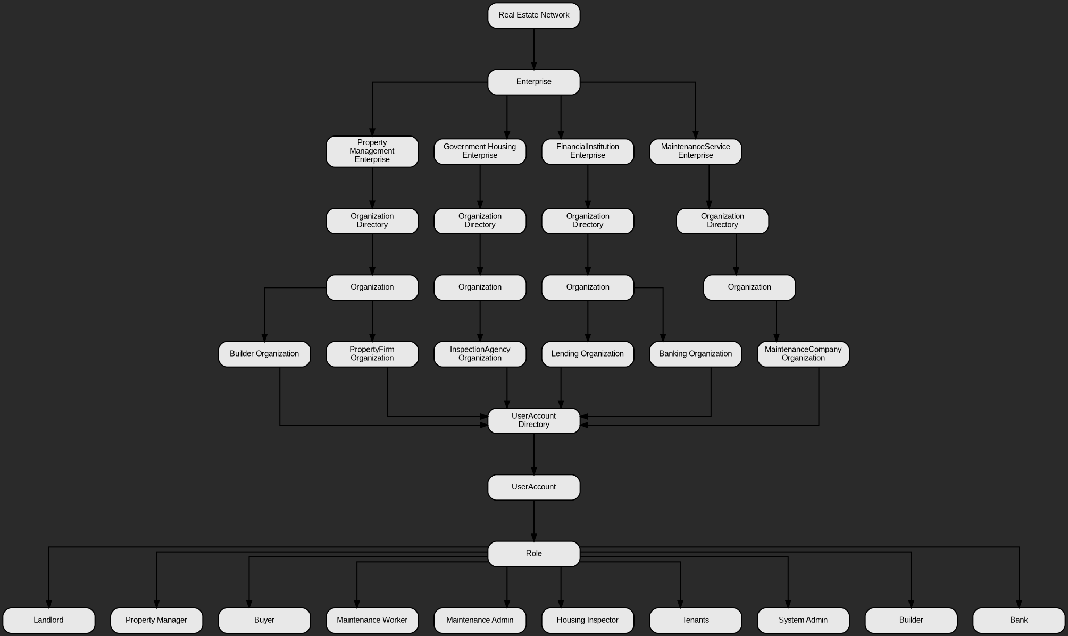
UML diagram

Slide 6
Property Management Enterprise:
Organizations | Roles
1.) Property Firms Organization: Manages property listings | Property Manager
2.) Lending Organization: Holds landlord details. | Landlords
3.) Builder Organization: Contains builder offerings | Builders

Slide 7
Maintenance Service Enterprise:
Organizations:
Maintenance Service Organization: Handles repair and maintenance requests efficiently.
Roles:
Maintenance Workers: Perform repairs.
Maintenance Admin: Manages requests and assignments.

Slide 8
Financial Institution Enterprise:
This enterprise focuses on financial aspects within the system. It provides essential services for property transactions.
Banking Organization:
Offers loan schemes for property purchases.
Bank Representatives:
Assist users with loan applications and inquiries.

Slide 9
Government Housing Enterprise:
Inspection Agency Organization:
Conducts property inspections to ensure compliance and safety standards
Housing Inspectors:
Perform detailed property assessments and generate reports
User Account Directory:
Holds all user accounts with various roles: Buyer, System Admin, Tenants.

Slide 10
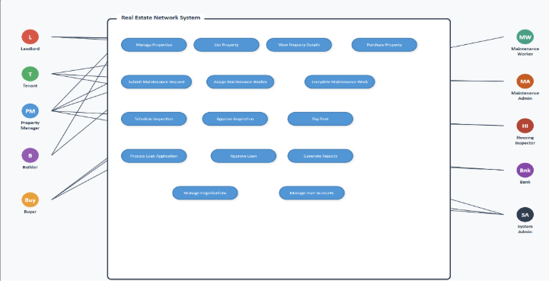
Use Case diagram

Slide 11
Use Cases
Property Search and Booking:
1.) A buyer logs into the platform to search for properties.
2.)The system provides a list of available properties with details and booking options.
3.)User can reserve a viewing, request details or proceed with a booking
Request for Maintenance Services:
1.) A tenant submits a request for maintenance (e.g., plumbing or electrical work).
2.)The platform assigns the request to an available maintenance worker.
3.)Tenant can track the status of the request and receive updates when work is done

Slide 12
Use Cases:
Schedule Inspection:
1.) A landlord schedules an inspection for their property.
2.)The inspection agency reviews the request and assigns a housing inspector.
3.)The inspection agency reviews the request, assigns an inspector, and schedules the visit, with updates visible to the landlord.
View Loan Schemes:
1.)A buyer explores loan options from various banks.
2.)The platform displays comparative loan schemes, enabling the user to select the best fit.
3.)The user can compare options side-by-side and select a suitable loan pathway.

Slide 13
Use Cases:
Book Builder Services :
1.) A landlord plans to renovate their property.
2.) They search for builders, view their profiles and reviews, and book their services through the platform.
3.) After selecting a builder or contractor, the user can request quotes, schedule services, and track project progress.

Slide 14
THANK YOU !!!!!!
Presented by :
Niharika Thippeswamy
Mrudul Maruthi Kumar Reddy Mettukuru
Krishi Parekh
Meghana Thota

